Slide 1
Data Storage

Slide 2

Database Management System (DBMS)
Web
Forms
Embedded
SQL
Interactive
SQL
Applications
SQL Commands
DBMS
Query
Evaluation Engine
Concurrency
Control
Files and Access Methods
Recovery
Manager
Buffer Manager
Disk Space Manager
Database
Data
Indexes
Catalog
Notes:
Trace a transaction…

Slide 3
Data Storage
Two DBMS fundamental questions?
How do we store and manage very large volumes of data?
What representation and data structures best support efficient manipulation of data?
RAM model vs. I/O model of Computation
Notes:
I/O model attempts to minimize disk accesses although the algorithm on data in main memory is not what might be consider the best use of main memory.

Slide 4
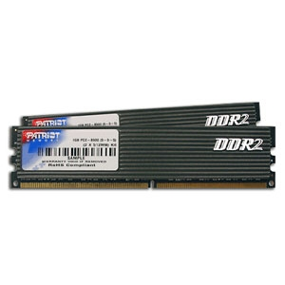
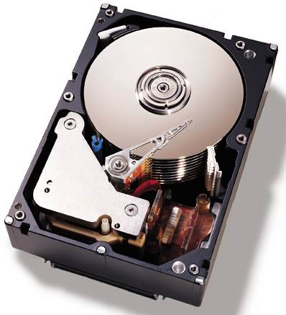
Storage Hierarchy
Speed; $$
Primary Storage: random access; volatile
Cache - on board or level-2 cache
Main memory
Secondary storage: random access; non-volatile
Flash-based or Solid State Disk
Magnetic disk
Virtual Memory (Main-memory DBS), File System, DBMS
Tertiary storage: non-volatile
Optical disk / juke boxes – random access
Magnetic cartridge / tape silos – seq. access
Notes:
Cache in Kbytes; less than 10 nanoseconds
Main Memory in 100MB to 10 gigabytes; 10-100 nanoseconds
Magnetic disks: floppy 1.4 M, Zip 100M, Jazz 250M, HD over 20gigabytes
2-40 msec
Optical disks: CD-ROM, CD-R, CD-RW (WORM) 640MB
DVD-ROM, DVD-R, DVD-RW 4.7-8.5GB per side
WORM are magnetic-optical storage devices
Tertiary storage: 2.5 gigabytes to over 50 gigabytes
2-10 seconds
Volatile main memory: DRAM chip, cheap and simple but needs refreshing
Non-vol. Main: RAM Disk, battery backup
flash memory (EEPROMs) but they can be rewritten 1 million times.
EEPROM: Electrically Erasable programmable ROM

Slide 5
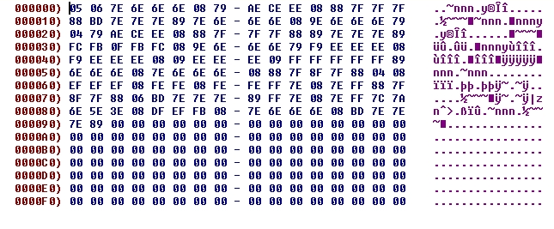
Data (Records/Columns) on Disk
Address
(offset)
not stored
Stored Data
Block 0
Data 0
Data 1
Data 2
Data 3
Block 1
Data 4
Data 5
Data 6
Data 7

Slide 6

Improving Access Time ?
What are the costs in I/O requests?
I/O cost = secondary storage access + queuing delays
disk access = seek time + rotational delay + transfer time
Block transfer, Buffering and Prefetching, Multiple/RAID disks
Queuing delays are reduced with scheduling
Elevator (Scan) Algorithm and its variations
Data access cost is reduced with data organization
Notes:
I/O cost = disk access + wait/queuing delays = seek time + rotation latency + data transfer rate + queuing
Disk access is reduced with data organization whereas queuing delays with scheduling.

Slide 7
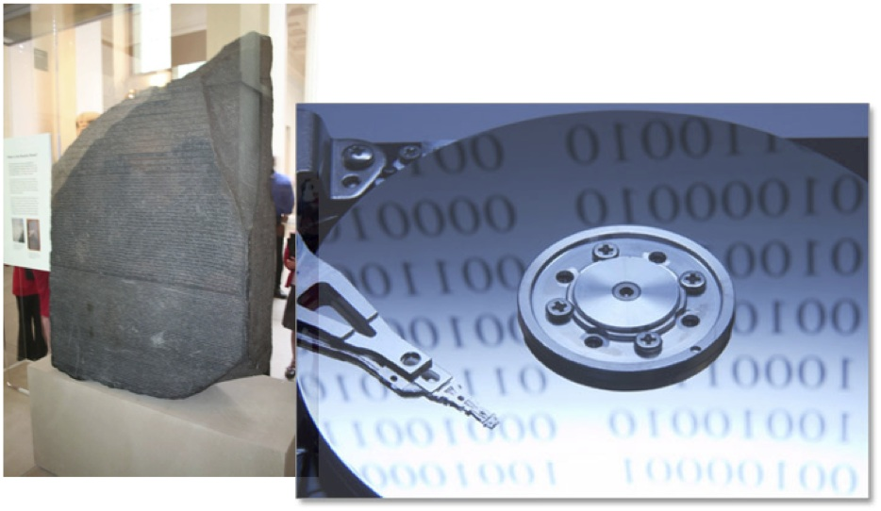
But first, how is data stored?

Slide 8
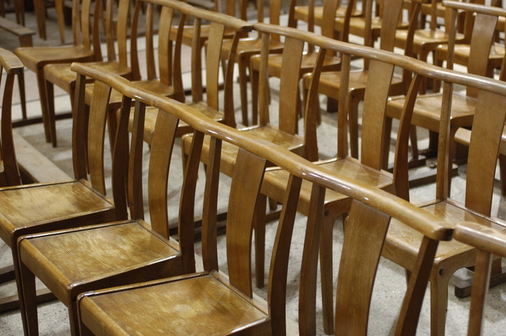
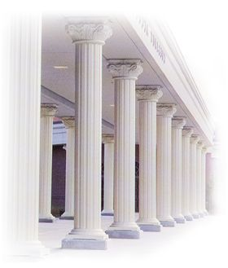
Two Store Approaches
Row Stores
Column Stores

Slide 9
Example Table
CREATE TABLE Student (
SID INTEGER
name CHAR(16),
address CHAR(130),
gender CHAR(1),
birthdate DATE
);
DATE: 10-char string YYYY-MM-DD Fixed-length character string char(10)
example: 2002-09-15

Slide 10
Row Stores
gender
156
SID
name
address
0
4
20
152
birthdate
Store fields in one record contiguously on disk with word allignment
Use small (e.g., 4K) disk blocks
unspanned
block header record1 record2 … record3
block header record1 record2 … record3
block header record4
spanned
record4
Notes:
Record (tuple, data item, object)

Slide 11
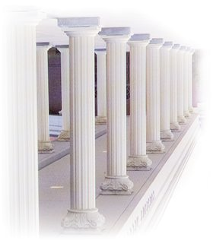
Column Stores
SELECT SID, gender FROM Students;
gender
Birthday
Name
SID
Address

Slide 12
File Types
Unordered files
Ordered files
Clustered files
Hash files
File header or descriptor includes:
field names and their data types
address of the file block on disk
File header block1 block2 … blockN

Slide 13

Unordered Files
The simplest file structure: records are stored in no particular order
Also called: Heap, Pile, or Random File
New records are inserted at the end of file
The last disk block is copied into buffer (i.e., memory)
New record is added
Block is rewritten back to disk
Record insertion is quite efficient

Slide 14
Example of Heap File
CREATE TABLE deposit (
account_number CHAR(10),
branch_name CHAR(22),
balance REAL
)
Block 1
Block 2
Record 0 | A-102 | Oakland | 400
Record 1 | A-305 | Shadyside | 350
Record 2 | A-101 | Downtown | 700
Record 3 | A-222 | Squirrel Hill | 500
Record 4 | A-217 | Shadyside | 900
Record 5 | A-110 | Waterfront | 340
Record 6 | A-257 | Oakland | 600
Record 7
Notes:
Q: How many bytes will a record need if we must have everything aligned by multiples of 4?
A1: 10➔12, 22➔24, 8➔8, therefore we need 44 bytes total

Slide 15
Heap Files: Insert
Insert Record 7
Record 0 | A-102 | Oakland | 400
Record 1 | A-305 | Shadyside | 350
 | A-101 | Downtown | 700
Record 3 | A-222 | Squirrel Hill | 500
Record 4 | A-217 | Shadyside | 900
Record 5 | A-110 | Waterfront | 340
Record 6 | A-257 | Oakland | 600
Record 7
Record 0 | A-102 | Oakland | 400
Record 1 | A-305 | Shadyside | 350
 | A-101 | Downtown | 700
Record 3 | A-222 | Squirrel Hill | 500
Record 4 | A-217 | Shadyside | 900
Record 5 | A-110 | Waterfront | 340
Record 6 | A-257 | Oakland | 600
Record 7 | A-354 | Oakland | 420

Slide 16
Heap Files: Delete
remove Record 2
Record 0 | A-102 | Oakland | 400
Record 1 | A-305 | Shadyside | 350
Record 3 | A-222 | Squirrel Hill | 500
Record 4 | A-217 | Shadyside | 900
Record 5 | A-110 | Waterfront | 340
Record 6 | A-257 | Oakland | 600
Record 7 | A-403 | Downtown | 250
Record 0 | A-102 | Oakland | 400
Record 1 | A-305 | Shadyside | 350

Record 3 | A-222 | Squirrel Hill | 500
Record 4 | A-217 | Shadyside | 900
Record 5 | A-110 | Waterfront | 340
Record 6 | A-257 | Oakland | 600
Record 7 | A-403 | Downtown | 250
Record 2 A-101 Downtown 700

Slide 17
Heap Files: Insert & Delete (optimized)
remove Record 2
add Record 8
Record 0 | A-102 | Oakland | 400
Record 1 | A-305 | Shadyside | 350

Record 3 | A-222 | Squirrel Hill | 500
Record 4 | A-217 | Shadyside | 900
Record 5 | A-110 | Waterfront | 340
Record 6 | A-257 | Oakland | 600
Record 7 | A-403 | Downtown | 250
Record 0 | A-102 | Oakland | 400
Record 1 | A-305 | Shadyside | 350
Record 8 | A-354 | Oakland | 420
Record 3 | A-222 | Squirrel Hill | 500
Record 4 | A-217 | Shadyside | 900
Record 5 | A-110 | Waterfront | 340
Record 6 | A-257 | Oakland | 600
Record 7 | A-403 | Downtown | 250
-- Periodic reorganization: records are packed by removing deleted records

Slide 18

Properties of Unordered Files
File records are inserted at the end of the file or in any file block with free space.
Thus, insertion is efficient.
To search for a record, a linear search through the file records is necessary which is quite expensive.
Reading the records in order of any field requires sorting the file records.

Slide 19
Ordered Files
Also called sequential files.
File records are kept sorted by the value of an ordering key which has unique value (e.g., primary key)
CREATE TABLE deposit (
account_number CHAR(10),
branch_name CHAR(22),
balance REAL
)
Record 0 | A-101 | Downtown | 700
Record 1 | A-102 | Oakland | 400
Record 2 | A-205 | Shadyside | 350
Record 3 | A-217 | Shadyside | 900
Record 4 | A-222 | Squirrel Hill | 500
Record 5 | A-310 | Waterfront | 340
Record 6 | A-357 | Oakland | 600
Record 7 | A-403 | Downtown | 250
Fixed-length records
10 + 22 + 8 = 40 bytes
Notes:
Q: How many bytes will a record need if we must have everything aligned by multiples of 4?
A1: 10➔12, 22➔24, 8➔8, therefore we need 44 bytes total

Slide 20
Properties of Ordered Files
Insertion is expensive: records must be inserted in the correct order.
Deletion?
Search for a record on its ordering field value is quite efficient (binary search algorithm).
Search for a record on a non-ordering field?
Reading the records in order of the ordering field is also quite efficient.
Reading the records in any order?

Slide 21
Clustered Files
Order files with ordering field which is not a key
Ordering field has not a unique value
DEPTNUM
1
1
1
2
2
3
3
3
3
3
4
4
NAME
SSN
JOB
BIRTHDATE
SALARY
5
5
5
5
6
6
6
6
6
8
8
8
Properties?
Purpose ?

Slide 22
Clustered File: Example 2
For efficient insertion, deletion and search, each group of records with different ordering field is stored on separate block
1
1
1
Block
Pointer
2
2
Block
Pointer
3
3
3
3
Block
Pointer
3
Block
Pointer
4
4
Block
Pointer
5
5
5
5
Block
Pointer

Slide 23
Hash Files
Also called direct files
External hashing maps keys to disk blocks
Works similar to internal hashing
Static hashing
Dynamic file expansion
Linear hashing
Extendible hashing

Slide 24
Static Hashing
Hashing converts the key of a record into an address in which the record is stored.
An external hash function maps the key to the relative address of a bucket in which the record is stored.
if a file is allocated s buckets, the hash function must convert a key k into the relative address of the block:
h(k)∈{0, ..., s-1}
A bucket is either one disk block or a cluster of contiguous blocks
A table stored in the header of the file maps relative bucket numbers to disk block addresses.

Slide 25
Static Directed File
0 | 1 | 2 | 3 | … | S-1
File Header
h(k)
k
0
1
2
3
..
S-1
k % S

Slide 26
Static Directed File
0 | 1 | 2 | 3 | … | S-1
File Header
h(k)
k
0
1
2
3
..
S-1
k % S

Slide 27
Collision
Insertion of a new record may lead to collision.
No space in B = h(k)
Probing or conflict resolution:
Open Addressing (Rehashing): If bucket h(k) is full, use another hash function until a bucket with a free space is found.
E.g., linear probing
α = h(key) = key mod s
rh(α) = h (α +1)
Not a very good technique for databases (Why?)
Chaining: Use overflow buckets.

Slide 28
Static Directed File
0 | 1 | 2 | 3 | … | S-1
File Header
h(k)
k
0
1
2
3
..
S-1
k % S
Overflow Bucket Blocks
Each bucket has its own overflow blocks

Slide 29
Handling of the Overflow Area
Three approaches:
Common overflow area for all blocks in the file.
Each block has a pointer to its first record in the overflow area.
Records belonging to the same block are linked by pointers.
Overflow Area

Slide 30
Handling of the Overflow Area
Share overflow area by some blocks
e.g., residing on the same cylinder.
Individual overflow areas
Each block has its own overflow
Records are not linked

Slide 31
Hashing Functions
A good hash functions must
be computed efficiently
minimize the number of collisions by spreading keys around the file as evenly and uniform as possible.
Example of good functions
truncation
division: h(key) = key mod s
Mid-square
Folding or partitioning
Other ad hoc methods
Order preserving hash functions:
Maintain records in order of hash field values
Notes:
Order preserving: special case when keys are generated in order
Like the leftmost three digits of an invoice as hash address and sort records by invoice number within buckets.

Slide 32
Pros and Cons of Hashing
Excellent performance for searching on equality on the key used for hashing (assuming low density).
Records are not ordered (heap files).
⇒ Any search other than on equality is very expensive (linear search or involves sorting).
Prediction of total number of buckets is difficult.
allocate a large space.
estimate a ``reasonable'' size and periodically reorganize.

Slide 33
Dynamic Hashing Methods
Allow the file size to change as records are added or deleted.
Linear Hashing
No additional structure
Extendible Hashing
Binary Hashing

